Slide 1


Working Paper No. 4
Team A
Roy Madpis - Rawaa Makhoul - Alexandra Fatieieva

Slide 2


Updates
Fixing our model by removing “total_pymnt_inv” column
To finalize the model selection we will use:
Accuracy
Negative predictive value
Weighted average of realized return gained from the SP

Slide 3


Finalize the model selection
Trying additional modelling approaches
Conclusion: We will keep our original model approach
Feature engineering
b
Conclusion: Extra attempts will be made in the following steps

Slide 4
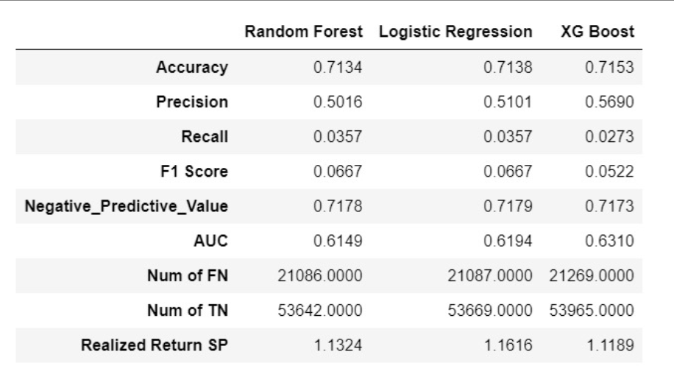

Finalize the model selection
Feature Selection
Conclusion: For now, the feature selection didn’t yield a much better-performing model (it didn’t increase the accuracy)
Final Selection of model’s type + Tune Hyper Parameters
Final model - XGBoost
Tune Hyper-parameters - main obstacle we faced was computation time.
Our solution: rather than using a grid search we used Halving GridSearchCV.

Slide 5

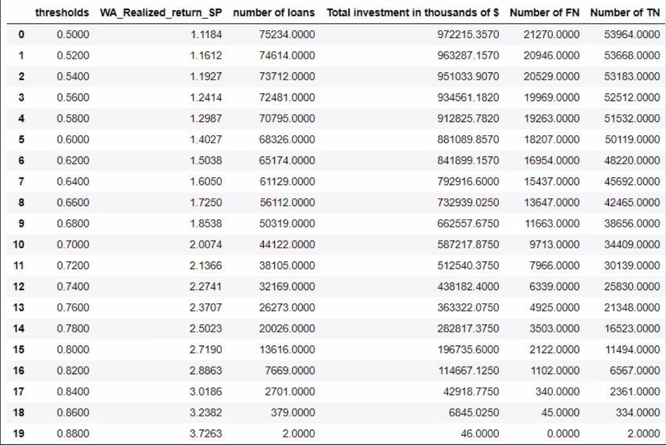

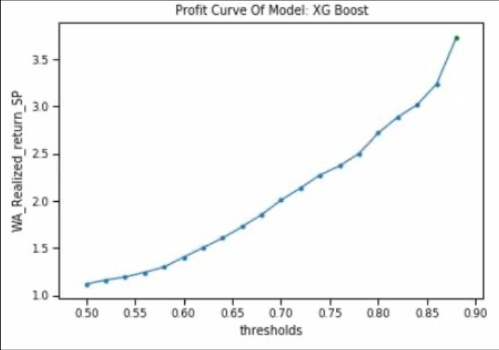
Finalize the model selection
Threshold = 0.75:
Profit curve
Threshold table
We decided to use a threshold of 0.75 - thus, get a weighted average that is higher than 2% without “losing” high quantity of loans.

Slide 6
Finalize the model selection
Evaluate Our Model’s Performance
Popular and well-known metrics: Accuracy, Precision, Recall, F1-score, NPV, AUC.
Unique Monetary Metric: Weighted average of the realized return of the Suggested Portfolio.
We must make sure our results weren’t influenced by a specific test set.
We created a cross-validation function that enables measuring the - Minimum, Maximum, Mean, and Standard Deviation (of the K folds) of the model’s performance
The baseline grades table of the model

Slide 7
The Baseline Grades Table
In order to evaluate how well the model’s performing regarding the monetary metric, we decided to use the given inner model - the grade column:
After grouping all the loans left due to our first data cleaning by the grade column, we calculated for each grade three things:
The weighted average realized return
The weighted Standard Deviation of the realized return
Number of loans

Slide 8


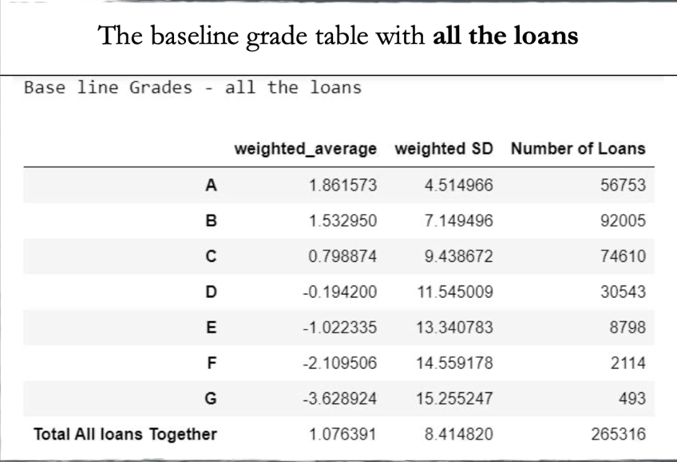
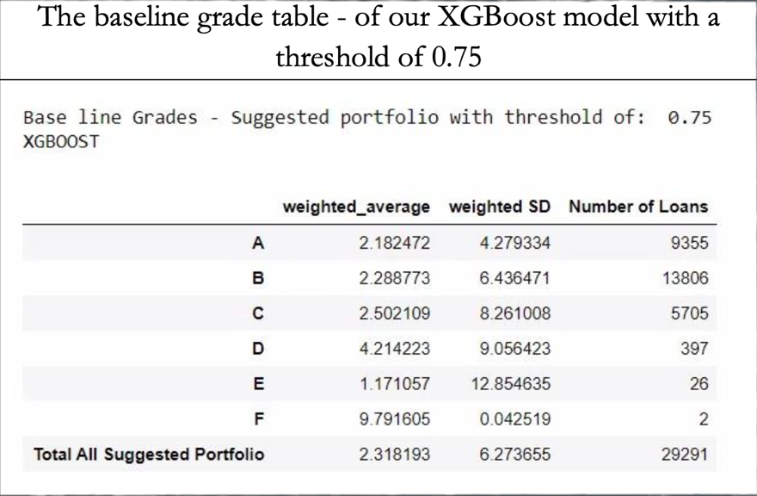

Slide 9
We claim that if we are able to create a model that can generate a Suggested Portfolio that its “baseline grades table” is better than the original “baseline grades table” and can generate a weighted average realized return that is higher than 2% - then, we will have a “good” model

Slide 10

Plans for the next step:
In the following step, we will continue optimizing our model, i.e. continue the process of feature selection, parameter optimization and feature engineering. Hoping to get a better performance.

